Slide 1
2-3-4 Tree
mirafra
TECHNOLOGIES
(BST)
Presented by Narendran R

Slide 2
Objectives
Introduction.
Structures of Tree.
Principle of 2-3-4 Tree.
Properties & Features.
Insertion
Deletion
Application.
Advantages & Disadvantages.
Conclusion.

Slide 3
Introduction
2-3-4 Tree is a Self-balancing, Data structure.
It is also called as 4th order B-Trees / Multiway tree of order 4.
Non-leaf nodes should have at_least 1 - data item.
i.e., Node will not exist with 0 - data item
Non-leaf node always has “ one more link (child) ”
than its “ data item (root) ”
i.e., L=D+1
L → Number of Links (child of root)
D → Number of Data item (root)

Slide 4
Continue..
Each node is arranged in Sorted form.
2,3 and 4 – “How many child nodes present(inside root)“
in an given tree.
Nodes can be of the following three types:
2-Node: A node with 1-data item, has 2-Children.
3-Node: A node with 2-data item, has 3-Children.
4-Node: A node with 3-data item, has 4-Children.

Slide 5
Structure of 2-3-4 Tree
10
3
5
20 50 80
1 9
13 21 71
1 2
4
10 30 88
15
30 47
55 64 79
100
sibling
Neighbour (21)
sibling
sibling
Neighbour (30)
sibling
sibling
Neighbour (64)
sibling
1-Key
2-key
3-key
2-Child_node
3-Child_node
4-Child_node
2 - Node
3 - Node
4 - Node
Each Child node can hold 2 – neighbours (left/right) for its value

Slide 6
Principle of 2-3-4 Tree
50
10 < 50
80 > 50
For 2-Node :
2-node, has 1 key Value and Maximum of 2 children
For 3-Node :
3-node, has 2 key Value and Maximum of 3 children
For 4-Node :
4-nodce, has 3 key Value and Maximum of 4 children
10
80
10
40
54 > 40
7 < 10
7
54
25 >10 and 25< 40
25
100 > 81
70
10
81
5 < 10
5
100
68
77
68 >10 and 68< 70
77 >10 and 77< 81

Slide 7
Properties
S – Smaller value
M – Middle value
L – Larger value
Nodes can be of the following three types:
2-Node: A node with 1-data item, has 2-Children.
3-Node: A node with 2-data item, has 3-Children.
4-Node: A node with 3-data item, has 4-Children
A leaf may contain 1, 2, or 3 data-item.
(Search property is defined as shown diagram)
In 4 node, must have 3-data item (S,M and L)
S is greater than left child's item and less than middle-left child's item
M is greater than middle-left child's item and less than middle-right child's item
L is greater than middle-right child's item and less than right child's item
10 55 70
Data < 10
Data > 70
Data > 10 and < 55
Data > 55 and < 70

Slide 8
Continue..
Maintain height balance in all subtree.
(i.e.,) Based on its depth property
Allows the node in tree to expand to accommodate/balance insert values.
(i.e.,) Based on its Node-size Property
Searching & Traversing:
Follows Simple extension of algorithm used in 2-3 tree

Slide 9
Features of 2-3-4 Tree
Multiway tree of order 4.
Perfectly Balanced in Same level.
Reasonably easy to program and Efficient code.
Serve as introduction for Understanding B- Tree.
Useful to understand Concept of Red-Black Tree.

Slide 10
INSERTION

Slide 11
Algorithm for INSERTION
Searching:
start from root & compare item with all values in node.
If there no match, move down to appropriate sub tree.
repeat until you find match/reach of empty sub tree.
Parent node can’t be 4-node, So need to Separate
& accommodate it.

Slide 12
Continue..
If leaf is 2-node / 3-node, Add data to leaf (2-3 Binary tree) algorithm basis.
Smaller value - Must be in left of root.
Larger value - Must be in Right of root
If leaf is 4-node, split and promote then insert.
Split – Convert 4 node into 2 node.
Promote – Mid value of 4node to parent and proceed.

Slide 13
CASE : 1 Here 4-node is root ,we promote (mid) and split as two node during insertion. We get: 1-data/key item & 2 children
Special Cases for Insertion Process
promote
5 25 50
3key (root)
25
5
50

Slide 14
CASE : 2 Here 4-node at (left sub-tree) with parent (2-node), we promote (mid) to parent and split as two node. We get: 2-data/key item & 3 children
Continue..
100
promote
20 52 75
121
52 100
20
75
121
Splitting

Slide 15
CASE : 3 Here 4-node at (Right sub-tree) with parent (2-node), we promote (mid) to parent and split as two node. We get: 2-data/key item & 3 children
Continue..
100
promote
21
120 152 175
100 152
21
120
175
Splitting

Slide 16
CASE : 4 Here 4-node(left sub-tree) with parent (3-node), we promote (mid) to parent and split as two node. We get: 3-data/key item & 4 children
Continue..
100 119
promote
20 52 75
133
52 100 119
20
75
133
Splitting

Slide 17
CASE : 5 Here 4-node(Middle sub-tree) with parent (3-node), we promote (mid) to parent and split as two node. We get: 3-data/key item & 4 children
Continue..
30 119
promote
20
41 52 75
133
30 52 119
20
41
75
133
Splitting

Slide 18
CASE : 6 Here 4-node(Right sub-tree) with parent (3-node), we promote (mid) to parent and split as two node. We get: 3-data/key item & 4 children
Continue..
57 100
promote
20
85
120 152 175
57 100 152
20
85
120
175
Splitting

Slide 19
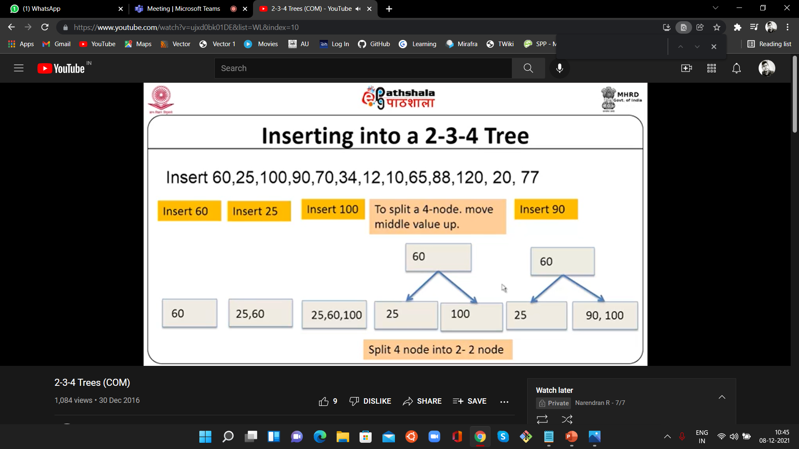
Example:-
Inserting : 60,25,100,90

Slide 20
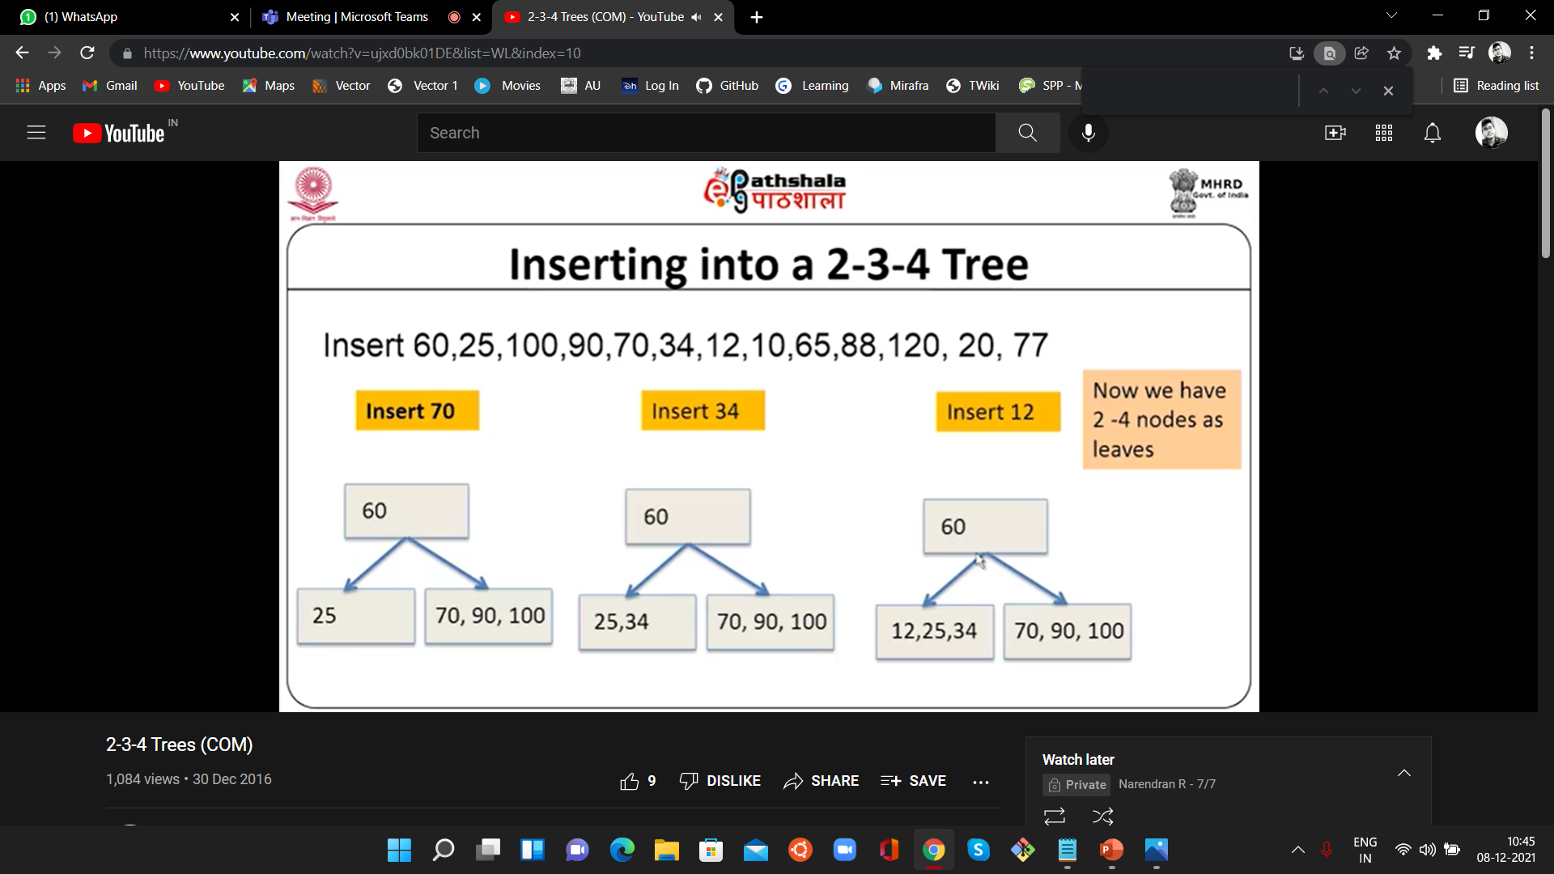
Inserting : 70,34,12

Slide 21
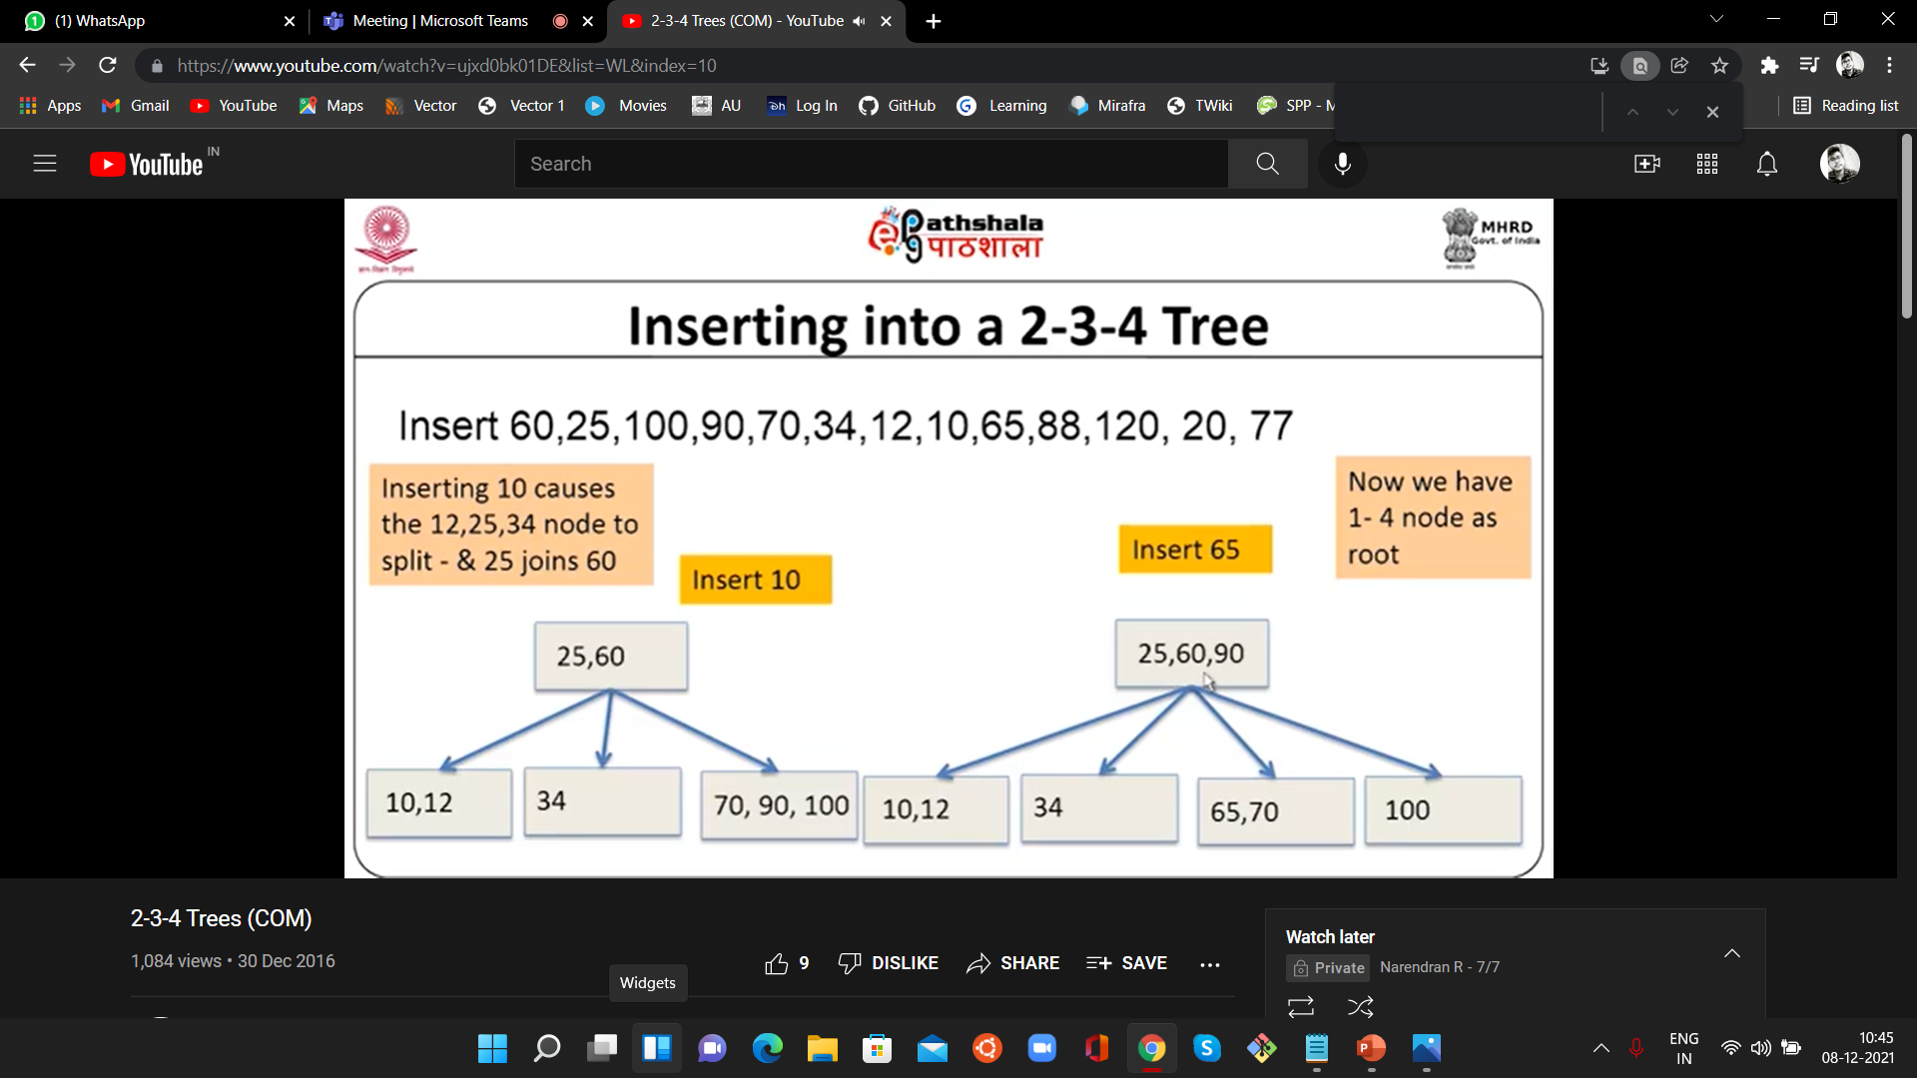
Inserting : 10,65

Slide 22
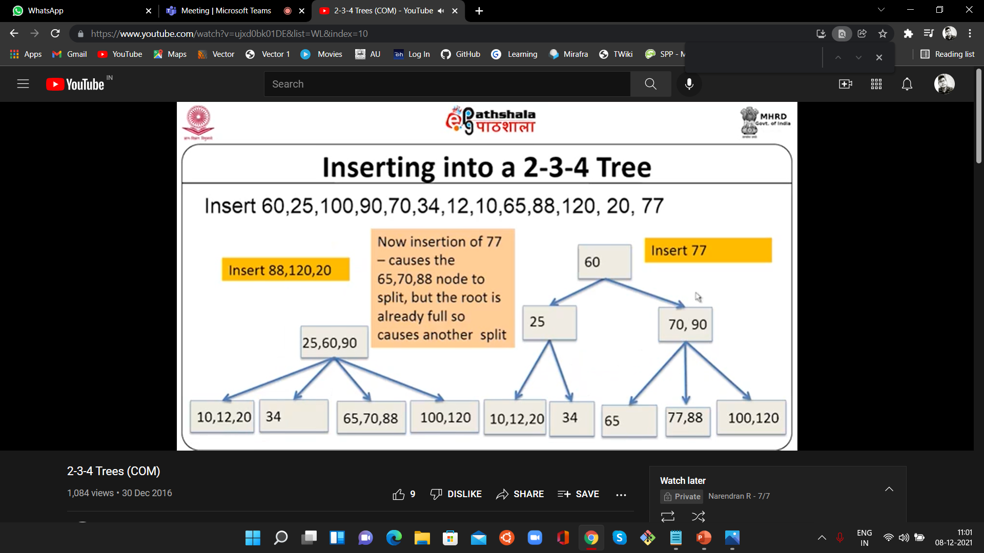
Inserting : 88,120,20,77

Slide 23
Pseudocode for INSERTION
insert(value,root)
{
if(root==null)
{
root = newnode(value); /* while 1st insertion we don't have root, create new node */
return;
}
if(root.data > value)
{
if(root.left==null) /* To check left subtree is free or occupied */
{
root.left=new node(value);
return; /* If space available in left subtree, insert and return */
}
insert(value, root.left); /* calling insert once & inform that i need to insert
value to left of sub tree only */

Slide 24
Continue..
}
if(root.data < value)
{
if(root.right==null) /* To check right subtree is free or occupied */
{
root.right=new node(value);
return; /* If space available in right subtree, insert and return */
}
insert(value,root.right); /* calling insert once & inform that i need to insert value
} to right of sub tree only */
}

Slide 25
DELETION

Slide 26
Algorithm for DELETION
Searching:
Compare - value from its root to each sub tree until it match.
After Finding - Swap data item with the in-order successor.
On way down the tree(both value & successor), convert
2-node into 3-node (or) 3-node into 4-node.
Ensure that deleted value must be in 3-node (or) 4-node leaf,
then remove value from leaf.
/*Note: 2-node leaf creates problem*/

Slide 27
Special Case for DELETION
Case 1: Element in Leaf Node with 2 Key/Values.
Delete it Straight forward.
Case 2: Element in Internal Node.
If left Child - 2 keys, Predecessor & delete.
If Right Child - 2 keys, Successor & delete.
Both child - 1 key, Merge & delete.
Case 3: Element in not Internal Node.
Node - 1 key with Sibling - 2 keys, Rotate element & delete.
Node - 1 key with Sibling - 1 key, Merge & delete.

Slide 28
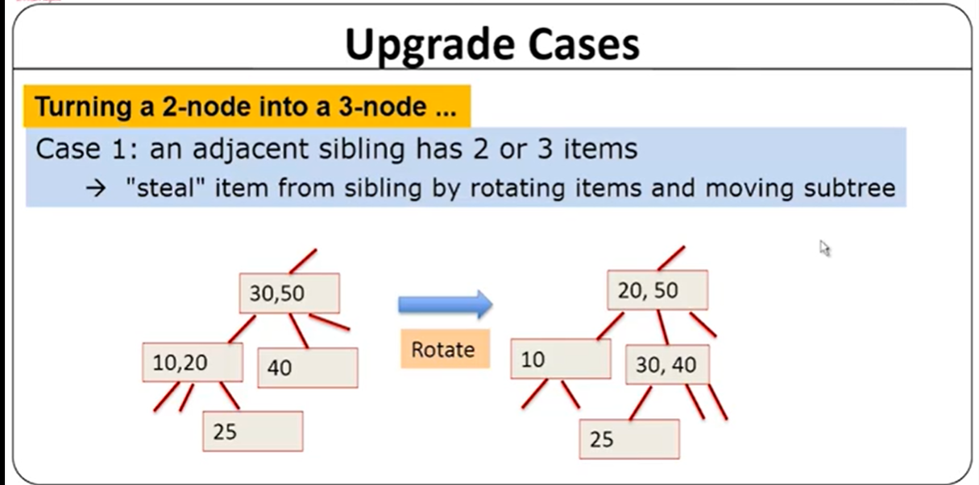
Continue..
NOTE: A leaf node should have atleast 1-neighbour to perform deletion (Balance)

Slide 29
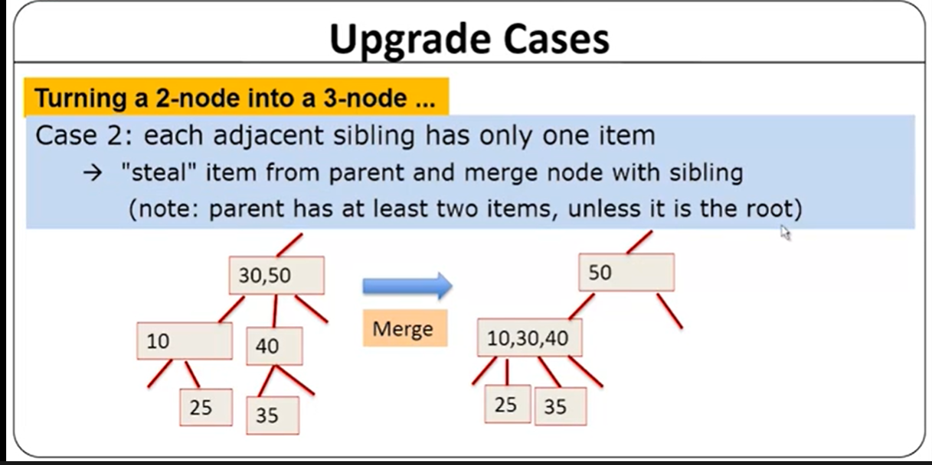
Continue..

Slide 30
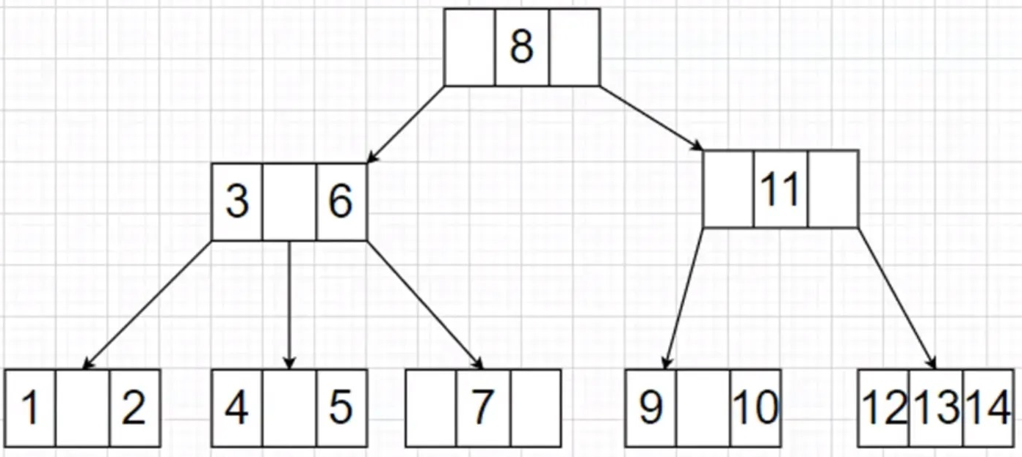
Deletion operation in sequence {1, 7, 6, 9, 3, 8}

Slide 31
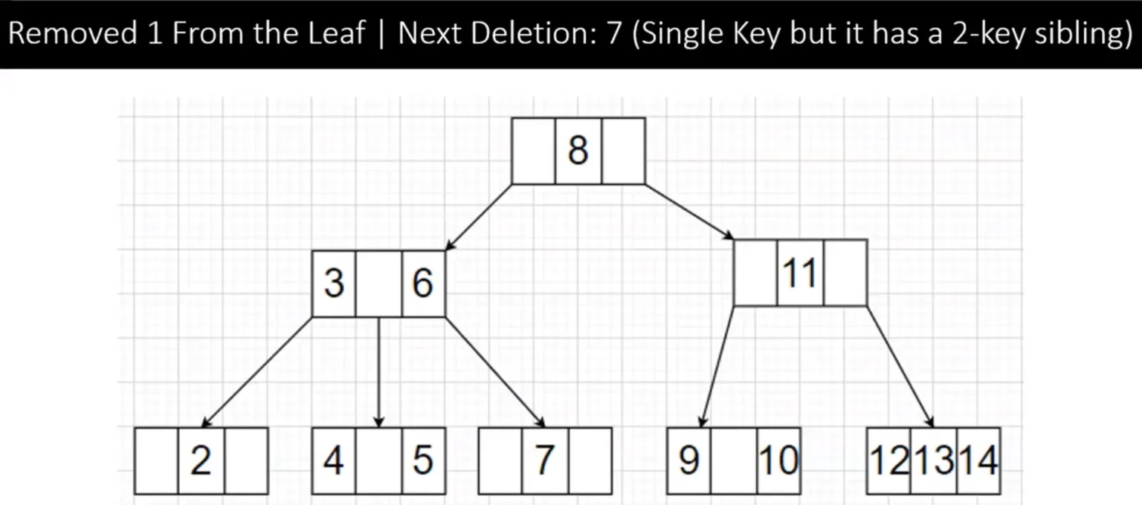
Removed : 1 || Next Deletion : 7 (Single key but it has 2 Key siblings)
Case 1: Element in Leaf Node with at-least 2 Key (1) (2)
So we delete it

Slide 32
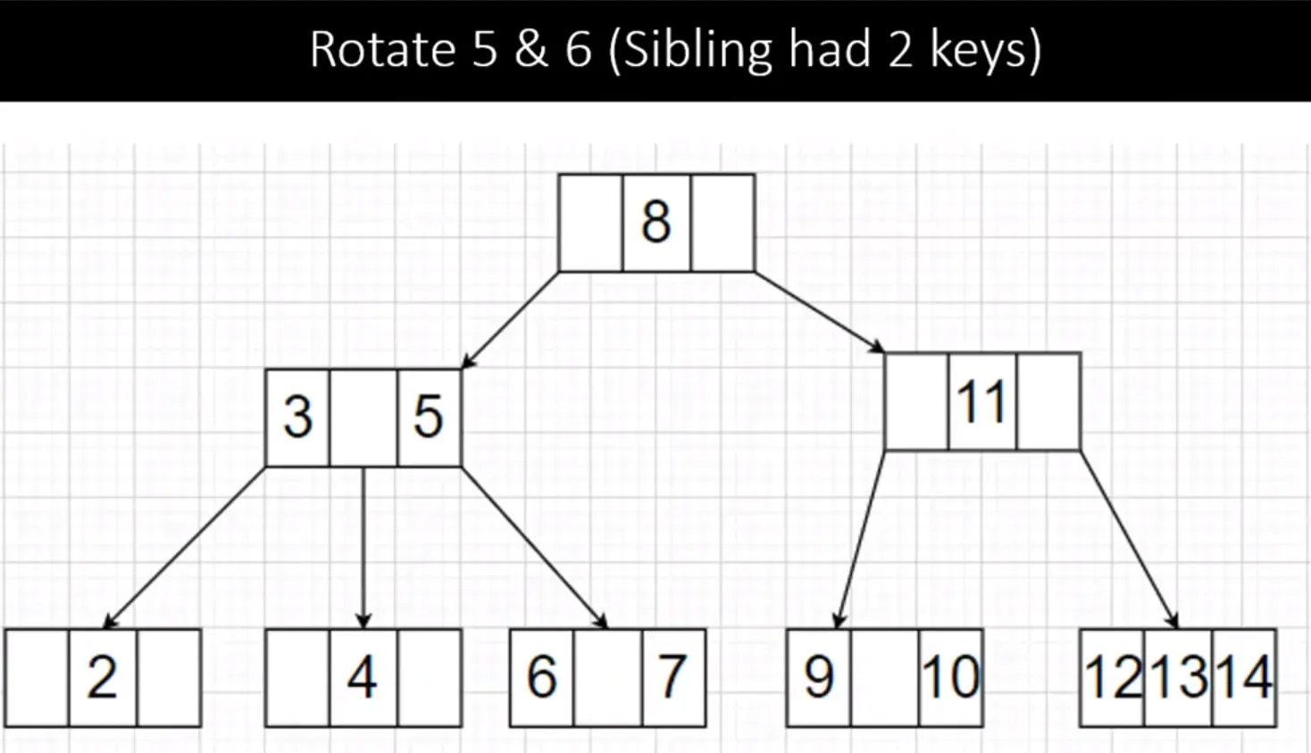
Rotate : 5 & 6 (Sibling had 2 keys)
Case 3 : Element is not Internal Node
Node - 2 keys(3)(6) with Sibling - 2 keys(4)(5),
Rotate & Delete it

Slide 33
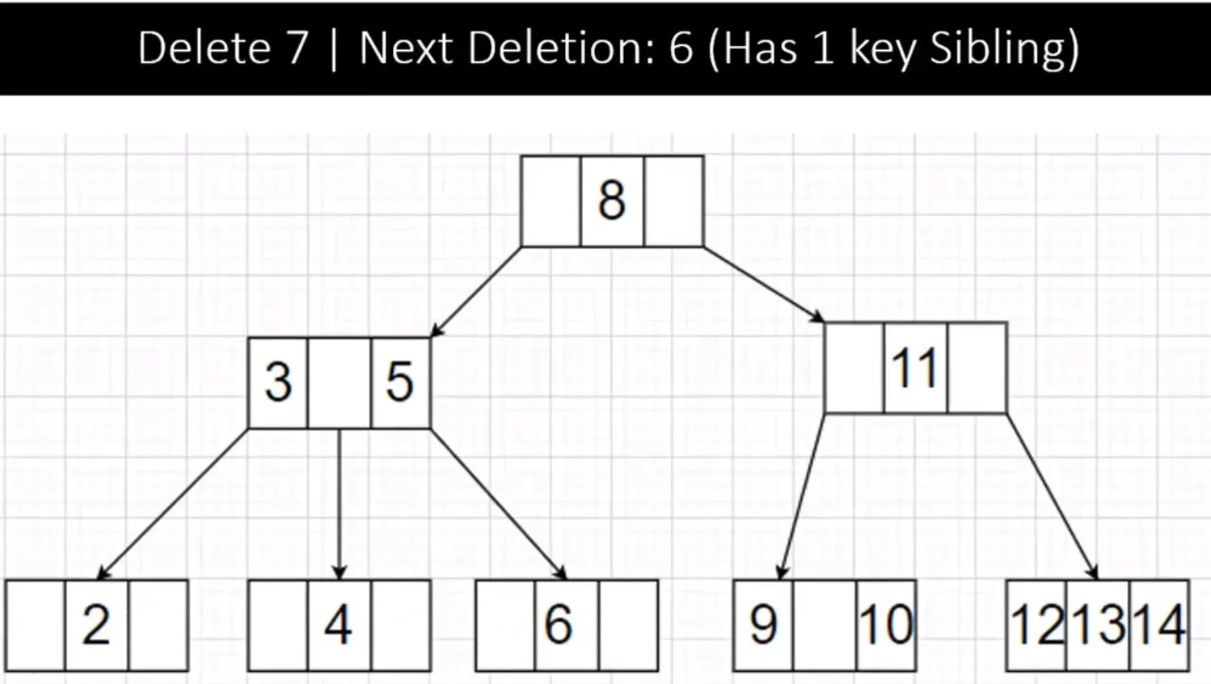
Removed : 7 || Next Deletion : 6 (Only 1 Key Sibling)
Case 1: Element in Leaf Node with at-least 2 Key (6) (7)
So we Delete it

Slide 34
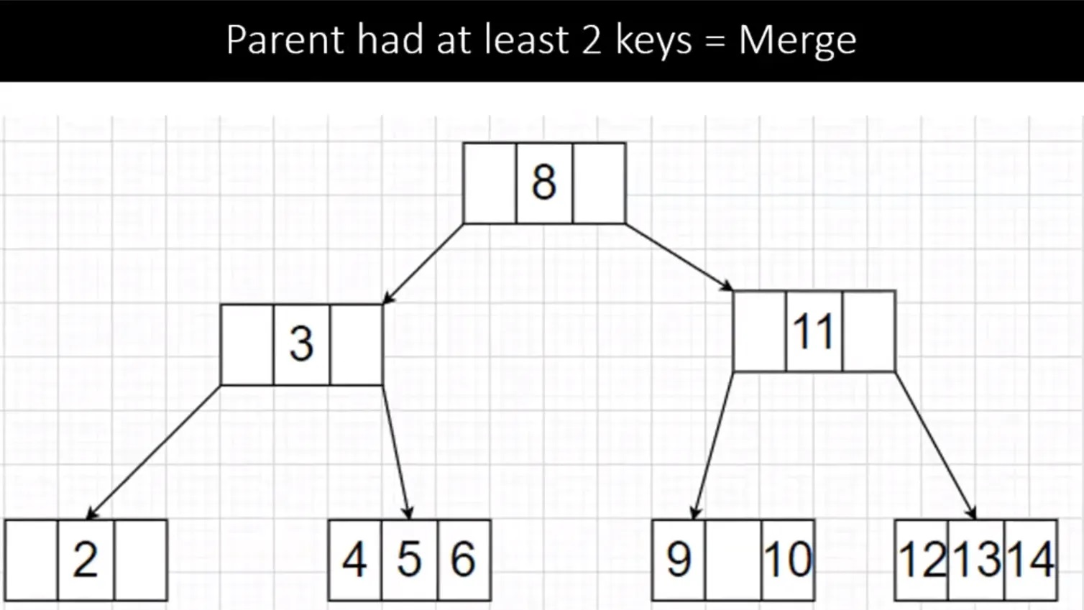
Parent had at-least 2 Keys : Merge
Case 3 : Element is not Internal Node
Node - 2 key (3) (5) with Sibling - 1 key (4),
Rotate element & Delete.

Slide 35
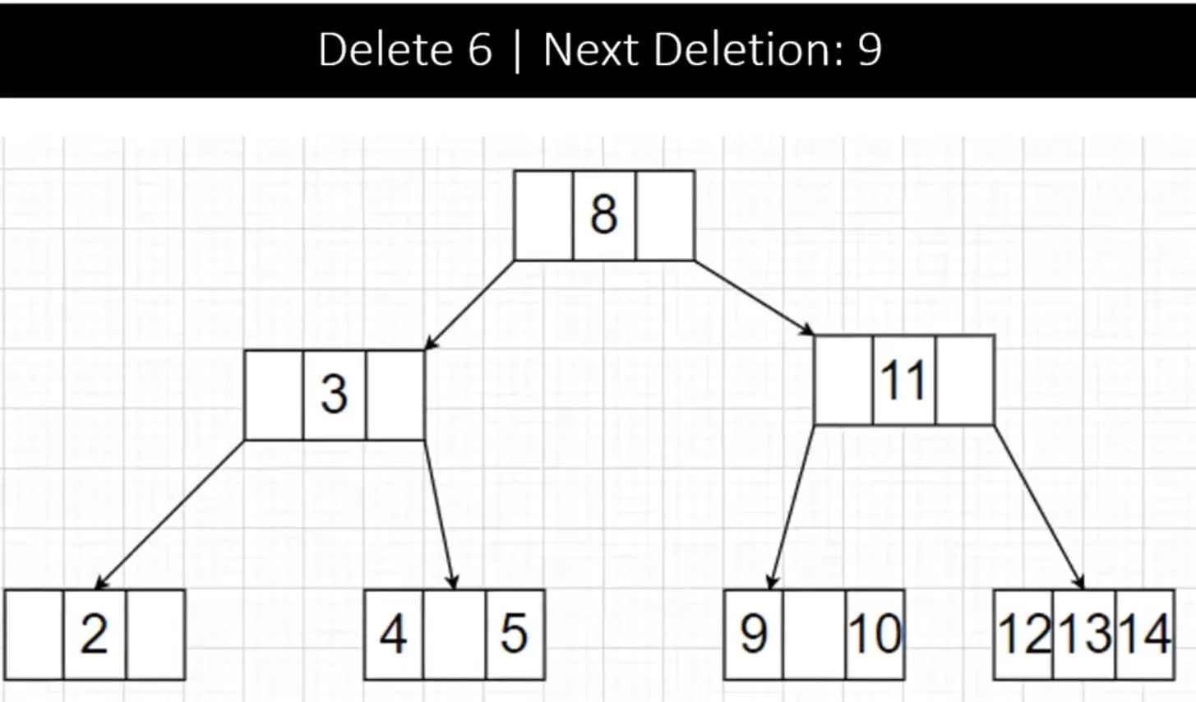
Removed : 6 || Next Deletion : 9
Case 1: Element in Leaf Node with at-least 2 Keys (4)(5)(6)
So we Delete it

Slide 36
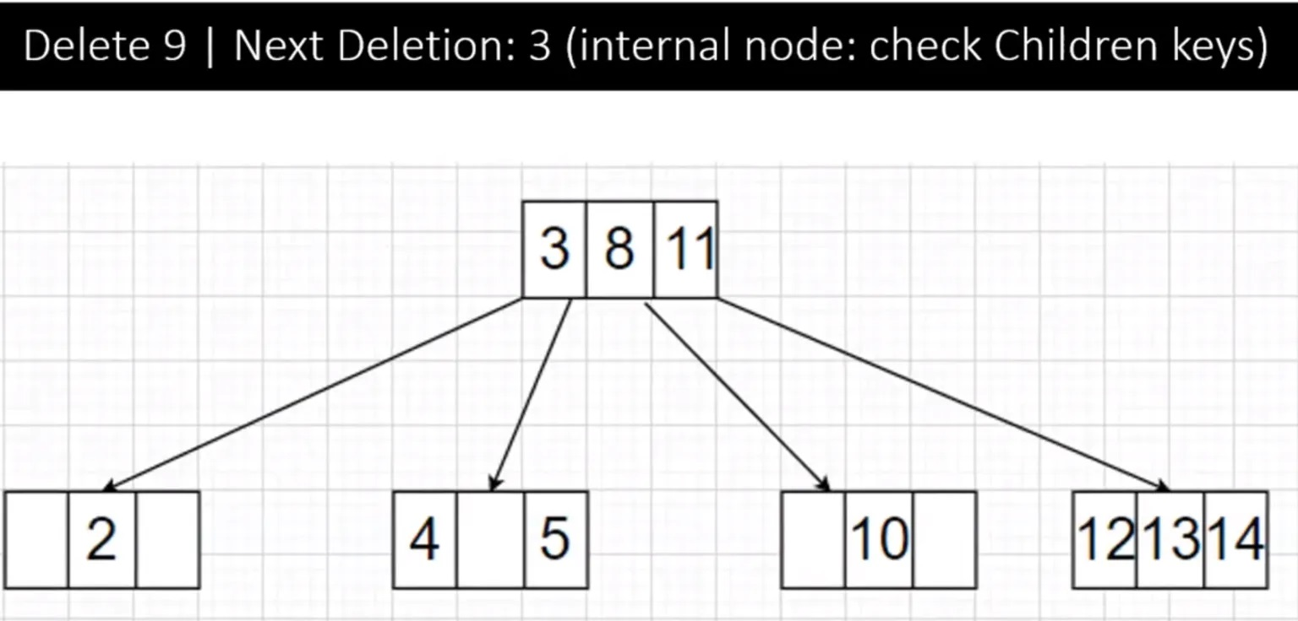
Removed : 9 || Next Deletion : 3 (int node : Check child keys)
Node – 1key(8) with Child – two 1keys(3)(11) = Merge them (3 8 11)
Case 1: Element in Leaf Node with 2 Key (9)(10)
So we Delete it

Slide 37
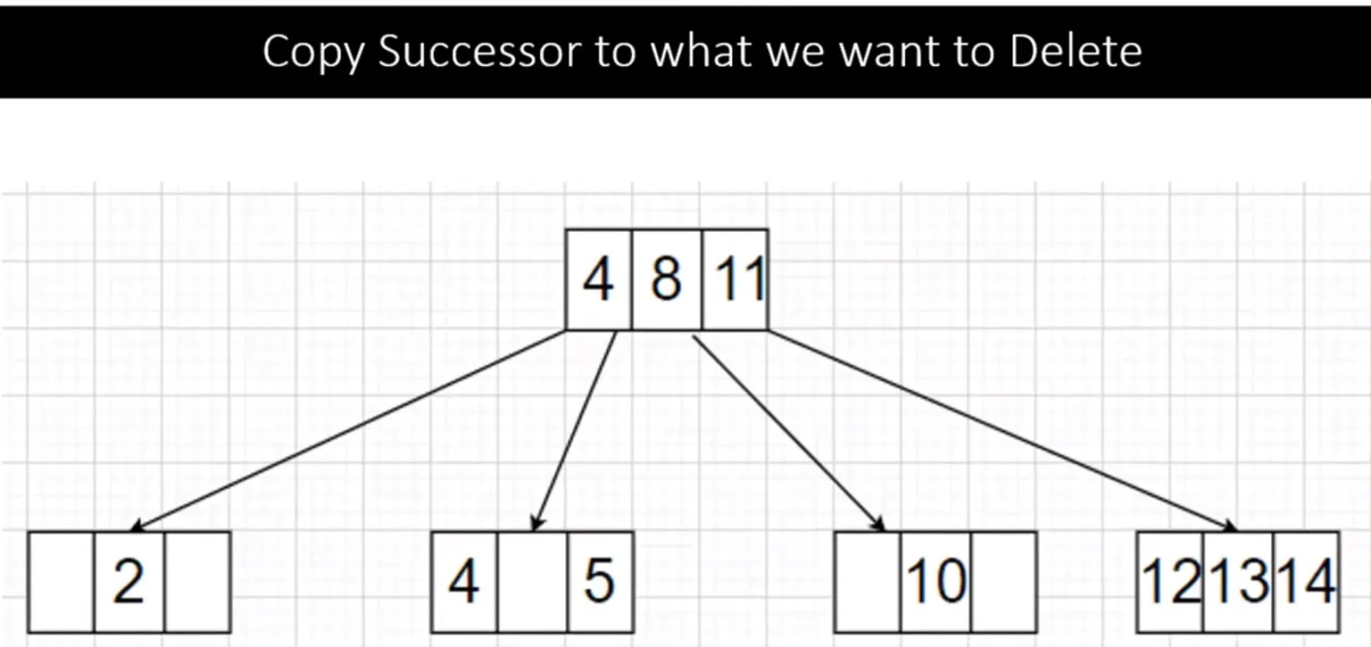
Removed : 3 | Copy Successor (To what we want to Delete)
Case 2 : Element is Internal Node
Right Child - 2 keys(4)(5) , replace (3) with successor (4)
Copy Successor(4) to parent.

Slide 38
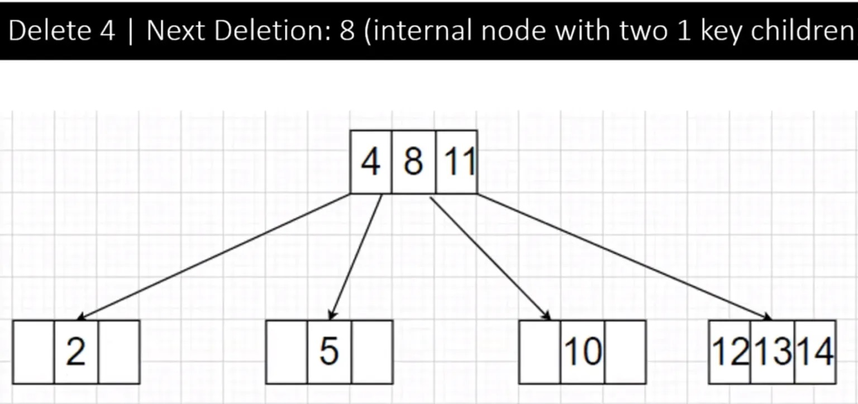
Removed : 4 || Next Deletion : 8 (int Node : with Two - 1Key children)
After replacing (3) with successor (4) in parent
Now Remove (4) from leaf node

Slide 39
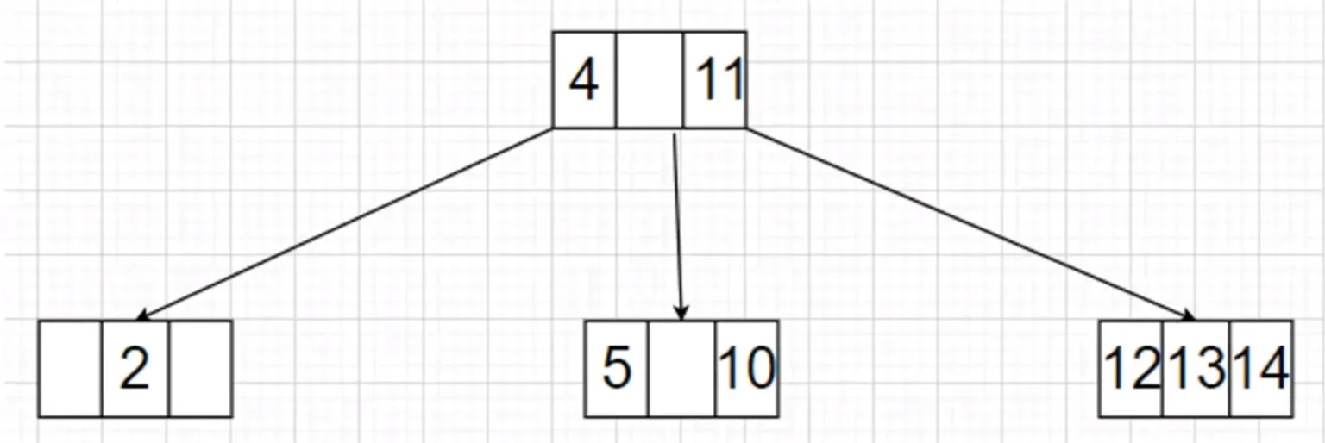
Before Removing : 8 (Merge : Parent had 2Keys)
Case 2: Element is Internal Node.
Both child - 1 key,
Merge & delete

Slide 40
Pseudocode for DELETION
node delete(value,root)
// node is return type
{
node x=search(value,root);
// searches value in tree , root
if (x==null)
{
return null; //value not found.
}
node ret = x; //copied x node to ret
if (isLeaf(x,root))
//CASE 1 : check x is leaf node..?
{
p=getparent(x,root); //returns parent of x
if (p.left.data== x.data) //x is left sub-child of p(T)
{
p.left=null; //if yes we break off
}
if (p.right.data==x.data) //x is right sub-child of p(T) {
p.right=null; //if yes we break off
}
return ret;
}

Slide 41
Continue…
If (onechild(x,root)) {
//CASE 2 : check x is node with 1-child..?
p=getparent(x,root); // we link parent to child x
if (p.left.data==x.data) {
// check x is left sub-child of p ?
if (x.left==null) { // x.right is single child of x (T)
p.left=x.right; // set LS of p as x.right
return ret;
}
if (x.right==null) { // x.left is single child of x (T)
p.left=x.left; // set LS of p as x.left
return ret;
}
}
If (p.right.data==x.data) {
// check x is right sub-child of p..?
if (x.left==null) { // x.right is single child of x
p.right=x.right; //set right subtree p as x.right
return ret;
}
if (x.right==null) { // x.left is single child of x
p.right=x.left; //set right subtree p as x.left
return ret;
}
}
}

Slide 42
Continue…
If (twochild(x,root)) {
//CASE 3 : check x is node with 2-children..?
p=getparent(x,root);
//we link parent to child x
i=getIS(x,root);
//to return (IS – In-order Successor) of x in tree with root
//x is 2 children, we need to replace x with in-order successor
if (p.left.data==x.data) {
//check x is left sub-child of p..?
p.left=i; //set IS to left subchild of p
i.left=x.left;
//replacing LSC x with i ,for IS process
i.right=x.right; //replacing RSC x with i
return ret;
}
if (p.right.data==x.data) {
//check x is right sub-child of p..?
p.right=i; //set IS to right subchild of p
i.left=x.left; //replacing LSC x with i
i.right=x.right; //replacing RSC x with i
return ret;
}
}
}

Slide 43
Applications
Better choice for indexing and storing data.
2-3-4 trees used to understand concept of the
Red-Black Trees.
Not widely used due to its complex structure and frequent change
in structure.

Slide 44
ADVANTAGES
Very efficient and Easier to implement.
Insertion & Deletion in BST is faster than B-tree.
Used to store as many nodes as possible.
Tree is Perfectly - Balanced Nature.
Insertion = O(log n).
deletion = O(log n).
search = O(log n).

Slide 45
DISADVANTAGES
Shape of the tree depends upon order of insertion.
Searching takes long time.
Recursive approach, which requires more stack space.
Tough implementation of balanced BST.
Access time is O(log n).

Slide 46
Thank you…
mirafra
TECHNOLOGIES

